Slide 1
‘Large’ Data Methods-An Introduction to Scalable Statistical Genomics in Linux
John McCallum john.mccallum@plantandfood.co.nz
Marcus Davy
Samantha Baldwin

Slide 2

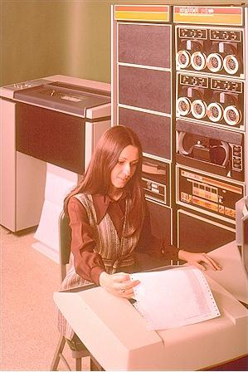




Slide 3
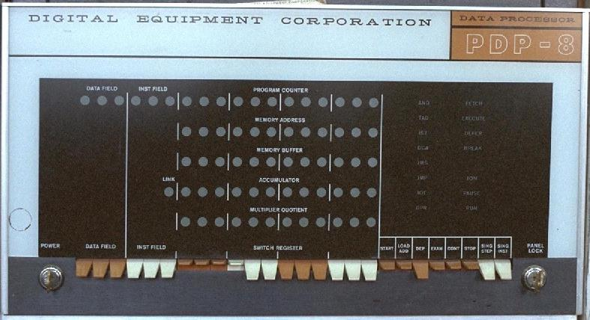

Slide 4
Statistical Genomics in 2012+
Larger is getting cheaper and larger
Context-specific SNP marker discovery
Population pool methods
Genotyping by sequencing
Global methods
Reference-based methods
Largeness requires scalable computing
  device < desktop < server < cluster < cloud
Diverse tools, scripts available for UNIX (ie OSX,Linux)
Web 2.0 options for social coding, analysis, sharing

Slide 5
GOALS
To introduce Unix as desktop and command-line environment + toolset for doing genetics
To explain a population genomic workflow with real data

Slide 6
Why Unix?
It makes the web and our phones work
OSX and current Linux desktops match or exceed Windows functionality
Leading platform for scientific computing
Secure
Scalable phone/desktop/server/cluster/cloud
Many flavours to suit your needs
freedom to work how you want, where you want, with (b)leading-edge tools

Slide 7
Agenda
An intro to the Unix environment (1 h+)
  Using a modern linux desktop and command-line
  Accessing servers and moving files
  Documentation and help
  Exploring file contents and formats
Running Analyses -Variant detection & analysis (1 h)
  Getting and using third-party scripts and executables
  Using bwa read mapper+samtools for variant analysis
  Comparisom among populations with Popoolation2
Visualization (1 h)
  Layering data in IGV
  with reshape2+ ggplot2 in R
  R and Galaxy (1/2 h)
  Rsamtools interfaces
  Marker design in Galaxy

Slide 8
The Data
Fragmented, barcoded PCR amplicons from flowering candidate genes from 7 onion populations, 2x 1/16 454 Ti plate
Parallel-Tagged Sequencing Meyer et al 2008 -now rendered obsolete but basically same workflow from eg Nextera XT
Raw data
  Genomic Reference fasta sequence (homozygous reference)
  Annotation of reference sequences from gmap (gff3)
  Fastq files, one per population per plate segment
Workflow
  Read mapping with BWA SW
  Manipulation and SNP calling with Samtools
  Population genetic analyses with PoPoolation2
  Visualization with IGV and R (reshape/ggplot2)
  PCR Marker design in Galaxy

Slide 9
Biological Question
Which SNPs in these genes show evidence of strong population differentiation?

Slide 10
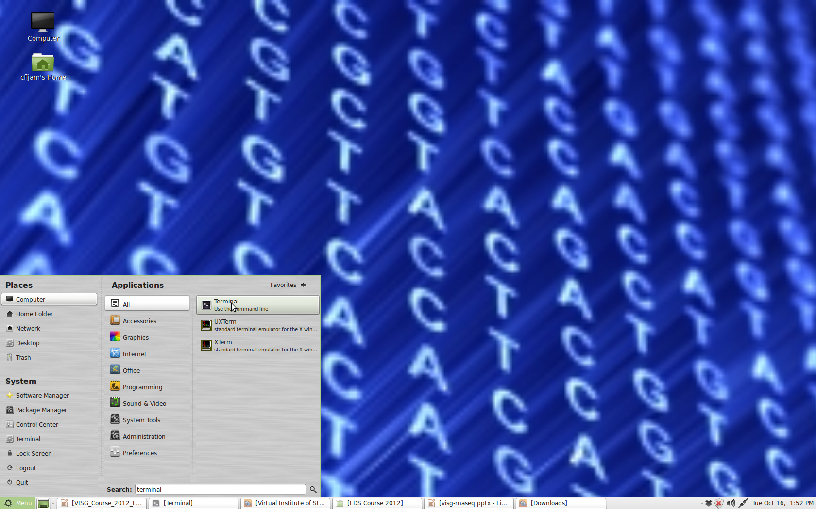
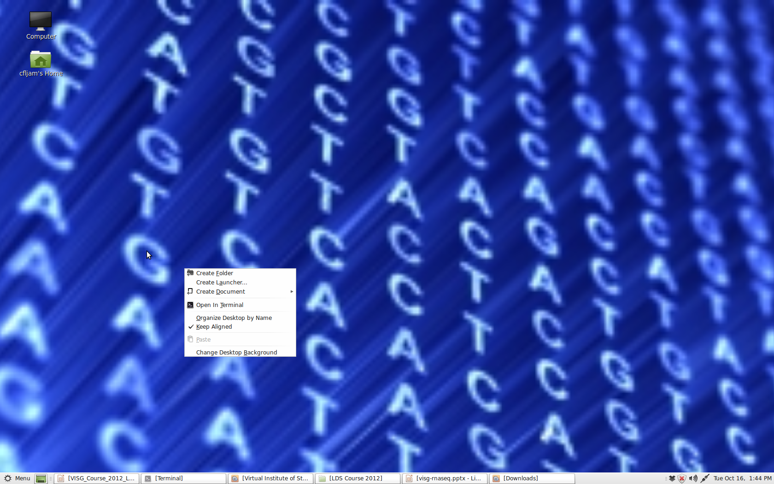
Accessing Terminal from Debian Linux Mint Desktop
Or right-click desktop and click this
Click to show menu
Click to show desktop
Search for stuff

Slide 11
> The bash shell
'Bourne-again-shell'
A command-line (CL) interface to operating system
a command interpreter
Command -option <value> argument(s)
Inputs and outputs from files or stdin/out
http://manuals.bioinformatics.ucr.edu/home/linux-basics

Slide 12
Exercise-Shell Orientation
whoami
pwd
ls
ls -l
cd /
ls
ls -la ~
cd
ls -l .
ls ..
Who are you?
Where are you?
List the files
Long listing
Go to root directory
List the files
Long listing of home plus hidden files
Go Home
List files in this dir
List the files in parent dir

Slide 13
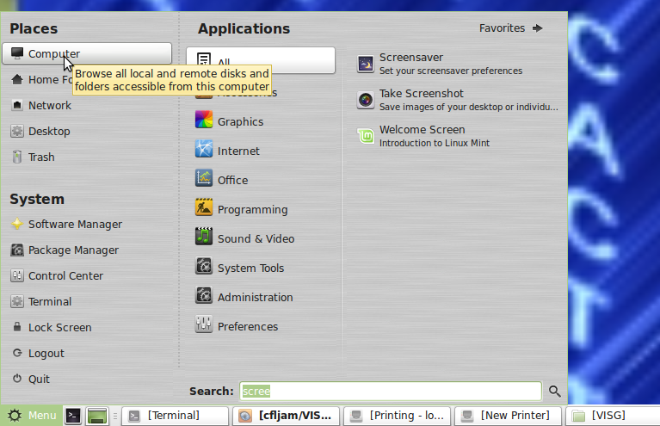
Get the Workflow and Data
Browse:https://github.com/cfljam/VISG-course-2012
git clone https://github.com/cfljam/VISG-course-2012.git ## get the archive
ls -l ##get a directory listing
ls -R * ##recursively list directory contents
tar -tvf VISG_LDS.tgz ##check the archive
tar -xvf VISG_LDS.tgz ##unpack it
ls -l ls -l 00.raw/ ##check there are data files
Browse the directories and archives with the file manager

Slide 14
Security==Permissions
Permissions protect you and the system from you and others
your sysadmin :-)
If you must....on this install
  sudo su ##to become admin
  sudo <do-something requiring admin rights> ## one-off
Each file/directory has
  Owner
  Group membership
  Permissions
Permissions links owner group size date name
-rw-r--r-- 1 visg_user visg 875 Oct 17 11:36 README.md
drwxr-xr-x 2 visg_user visg 4096 Oct 17 11:36 supplementary_QC
drwxr-xr-x 2 visg_user visg 4096 Oct 17 11:36 supplementary_samtools_usage
-rw-r--r-- 1 visg_user visg 22160684 Oct 17 11:37 VISG_LDS.tgz

Slide 15
Help!
help #list shell commands
help cd #help for cd command
man ls #read the man pages for ls, q to exit
<command> #may give help eg bwa
<command> --help # for some programs
Google..

Slide 16
Exercise CL Navigation & Wildcards
cd VISG-course-2012/00.raw
ls P<tab>
<tab> <tab>
ls Pool1_BARCODE*
ls Pool1_BARCODE?.fastq
ls Pool?_BARCODE[468].fastq
history
history | tail
<up arrow>
<down arrow>
< mouse double click>
<shift ins>
Move to raw data dir
List with filename completion
All the options
List the Pool1 files
List the Pool1 fastq files
List all barcode 4,6,&8 reads
see all the history
Last few items
Back in history
Forward in history
Copy
paste

Slide 17
Exercise-Explore
ls *.fastq #list to stdout
ls *.fastq > somefile #redirect to file
cat somefile #to stdout
cat somefile | head # pipe file to head
cat > somefile #read from stdin/ctrl d save

Slide 18
In Unix...everything is a File
Regular files-human readable text
Directories
Executable files
Compiled
Special text files
Symbolic links -'shortcuts'

Slide 19
Exercise -View, Browse and Search
cd /VISG/00.raw ##move to raw data dir
head Pool1_BARCODE2.fastq ##see top of file
tail Pool1_BARCODE2.fastq ##see bottom of file
less Pool1_BARCODE2.fastq ##view with the less pager
  h help screen
  g top of file
  G bottom of file
  /<pattern> search for pattern
  q quit less
grep @GYSS Pool1_BARCODE2.fastq | head ##get readnames
grep -c @GYSS Pool1_BARCODE2.fastq ##count reads

Slide 20
Gotchas-Symbols, Whitespace , Names
Stick to A-Za-z0-9_ for naming files
Non-printing characters
  Spaces and tabs
  Line endings: Unix=LF, Win =CR/LF
In shell environment many characters have special meaning e.g..
# comment
#! shebang
> redirect to
< input from
| pipe
$ variable expression
/ path delimiter
\ quote next character
'' strong quote
“” weak quote
` ` evaluate

Slide 21
Formats
Input and outputs should stick to standard common formats
Read the specifications!!!!!
Fasta – Raw nucleotide/peptide format
Fastq – Raw sequence information + quality
'Stream Formats'
  Sam/Bam format – Sequence Alignment/Map format
  GFF – General feature format-annotations
Tools for format conversion & filtering
  Unix tr, awk, sed, perl
  Programming Libraries Python, Perl, R etc
  Galaxy

Slide 22
Fasta format
Text-based format for storing nucleotide/peptide sequence(s)
Restricted to IUPAC alphabet letters
No spaces!
Header
>gi|63055|emb|V00385.1| Part of the chicken ovalbumin X gene
ACTGTGTCTTAGCACTCACTGCTTTGCTTCCTTCTTACAGGACAGATCAAAGATTTGCTTGTATCAAGCT
CCACTGATCTTGATACAACGCTGGTCCTTGTTAATGCCATCTACTTCAAAGGGATGTGGAAGACAGCATT
TAATGCAGAAGACACTCGAGAAATGCCCTTCCATGTAACAAAGGTAGGGGACGTAGTCACCGCTTCTGGG
...
Content
Newline wrap usually at 60 - 80 characters
http://en.wikipedia.org/wiki/FASTA_format

Slide 23
Fastq format
@HWUSI-EAS582_157:6:1:1:1501/1
NCACAGACACACACGAACACACAAAGACATGCCCATATGAAGAT
+
%.7786867:778556858746575058873/347777476035
@HWUSI-EAS582_157:6:1:1:1606/1
NCTGGCACCTTGATTTTGGACTTCCCAGCCTCCAGAACTGTGAG
+
%1948988888798988366898888648998788898888588
@HWUSI-EAS582_157:6:1:1:453/1
NCTGCTTGCACCCCTGAAGTCACTGATCACATTTCAGGGTCACC
+
%/868998988888867668888986644788988413488885
@HWUSI-EAS582_157:6:1:1:1844/1
NGATTGACATTGGCAAAGAGGACAACTGATTGCAAACTTCACAC
+
%-7;:::::;86499;75574586::635:62687666887879
@HWUSI-EAS582_157:6:1:1:1707/1
NAGGCTCAGGCGCACGGCCTACATCGTCGCTGTCGGCCAAGGGG
+
http://www.ncbi.nlm.nih.gov/pmc/articles/PMC2847217/ (Detail)
http://wiki.genomequest.com/index.php/NGS_Reads

Slide 24
Fastq format header
Header
@HWI-EAS209_0025_FC427:6:1:1041:14884#ACAGTG/2
AATTTGTTTGTTTGTTGTTTATTTTTTTGTTAGTTTCGTTTGTTGTTTGTTTGGATTTCCTCTGTGTTGAGTATTT
+HWI-EAS209_0025_FC427:6:1:1041:14884#ACAGTG/2
_________QZNUSUISNQW__U^BBBBBBBBBBBBBBBBBBBBBBBBBBBBBBBBBBBBBBBBBBBBBBBBBBBB
Illumina header contains several fields
HWI-EAS209 Unique machine identifier
0025 Run number
FC427 Unique flowcell identifier
6 Lane number
1 Tile number
1041 X coordinate within tile
14884 Y coordinate within tile
#ACAGTG illumina barcode multiplexing index tag
/2 Pair number (1 or 2)
Sequence
Header
Quality

Slide 25
Sequence alignment map format
sam – text format
Bam – binary version
  @HD VN:1.3 SO:coordinate
  @SQ SN:ref LN:45
  r001 163 ref 7 30 8M2I4M1D3M = 37 39 TTAGATAAAGGATACTG *
  r002 0 ref 9 30 3S6M1P1I4M * 0 0 AAAAGATAAGGATA *
  r003 0 ref 9 30 5H6M * 0 0 AGCTAA * NM:i:1
  r004 0 ref 16 30 6M14N5M * 0 0 ATAGCTTCAGC *
  r003 16 ref 29 30 6H5M * 0 0 TAGGC * NM:i:0
  r001 83 ref 37 30 9M = 7 -39 CAGCGCCAT *
http://samtools.sourceforge.net/SAM1.pdf
http://en.wikipedia.org/wiki/SAMtools
http://samtools.sourceforge.net/
http://samtools.sourceforge.net/samtools.shtml
[Keep it simple..., describing this format in detail is beyond the scope of the workshop]
Header
Alignments

Slide 26
GFF3 Format
Generic feature format
http://www.sequenceontology.org/gff3.shtml
Stream format-'one liners' of information about a feature
CO_Pool1_contig00004 reference cDNA_match 355 575 100 - . ID=JR851107.path1;Name=JR851107;Target=JR851107 500 720;Gap=M221
SOC1_Pool2_contig00003 reference cDNA_match 325 565 100 + . ID=JR848637.path1;Name=JR848637;Target=JR848637 2 242;Gap=M241
SOC1_Pool2_contig00003 reference cDNA_match 1320 1401 98 + . ID=JR848637.path1;Name=JR848637;Target=JR848637 243 325;Gap=M42 I1 M40
VIN3-like_Pool2_contig00005 reference cDNA_match 321 933 100 + . ID=JR853510.path1;Name=JR853510;Target=JR853510 1 613;Gap=M613
SOC1_Pool2_contig00003 reference cDNA_match 325 565 100 + . ID=JR848637.path1;Name=JR848637;Target=JR848637 2 242;Gap=M241

Slide 27
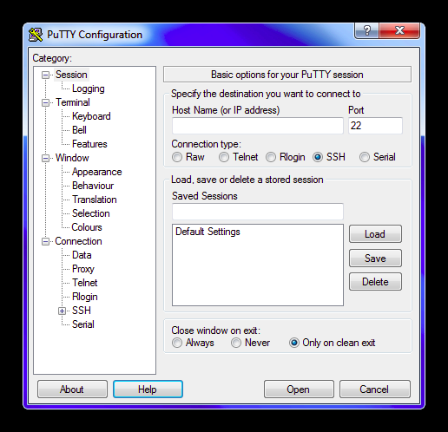
Important Freeware Tools
Linux -Live CDs/DVDs/USBs-use as installers
All platforms-Oracle VirtualBox
OSX
  Terminal
Windows
  Putty
  Xming
  Winscp
  Notepad++

Slide 28
Exercise-SSH and SCP
Get your IP address,swap with a partner
Check you can reach their IP address
SSH to each others machine as VISG_USER
Copy a file to your home dir
ifconfig | grep 'inet addr'
ping <their IP address>
ssh visg_user@<IP address>
scp visg_user@<IP address>:/VISG/00.raw/reference.fasta ~

Slide 29
>Feeling Overwhelmed Yet?
http://blogs.scientificamerican.com/guest-blog/2012/10/15/the-1000-genome-is-here-are-we-ready/

Slide 30
To keep sane, use approaches that are
Scalable & shareable
Open source
Reproducible
Documented
Identifiable
Disciplined

Slide 31
Reproducibility Questions
Where did these files come from?
What commands and options did I use?
What was I thinking?
How can I re-use this pipeline?
http://reproducibleresearch.net
http://cran.r-project.org/web/views/ReproducibleResearch.html

Slide 32
Community Support: Social Coding and Version Control
Code Sharing
Sourceforge
Github
Google Code
MyExperiment
Galaxy Toolshed
Version Control
SVN
Git
Both supported in RStudio
Worth learning about soon!

Slide 33
Reproducibility -A Simple Approach
Use one directory per atomic step, with an informative name
Prefix directory names with numeric order
Keep filenames consistent and informative
Paste step commands into an executable shell script file that will enable re-creation
Document stuff in
  In-line comments ##some comment
  Plain text README , with formatting in Markdown if desired
Version control using git

Slide 34
Where are My Tools: Scripts and Executables
echo $PATH ##where to look for executables
which bwa ##where is the bwa prog?
ls -l /usr/bin/bwa ##note x in the permissions
cd 05.reference/ ##move into a dir with run.sh
ls -l run.sh ##note x in the permissions
cat run.sh ##note shebang, denoting sh(bash) as interpreter
Important script interpreters
  sh (normally bash)
  Rscript (R)
  Python
  Perl

Slide 35
Exercise-Make a Shell Script
cd ~
mkdir test
cd test
cat > hello_unix.sh
#!/bin/sh
echo “hello ”
whoami
echo “number of lines in file listing is:”
ls -l .. | wc -l
<ctrl-d>
ls -l
Move to HOME
Make a dir
Move into it
Redirect to file (or use editor)
Enter each line, then return
Ctrl-d to finish
Check you have created a file, and its permissions

Slide 36
Exercise-Run/edit a Shell Script
cat hello_unix.sh
sh hello_unix.sh
./hello_unix.sh
chmod +x hello_unix.sh
./hello_unix.sh
cat >> hello_unix.sh
echo “another command”
<ctrl-d>
nano hello_unix.sh
cd ..
rm -r test
View the contents
Run using sh
Wont work
Make it executable
Should work
Append to the file
edit using nano
Move up a level
Delete the directory

Slide 37
Getting Programmes & Scripts
sudo apt-get install bwa #on Debian/Ubuntu Linux
wget curl <URL to file>
ftp ftp://somewhere.org/file.tgz
Check out from repository
  svn checkout <URI>
  git clone <URI>
May require
  Unzipping tar, gzip, GUI archive manager
  Compilation configure/make/make install
  Putting in your PATH or system PATH (as admin)

Slide 38
BWA Aligner
BWA= Burrows-Wheeler Aligner
Produces gapped alignment to reference
http://bio-bwa.sourceforge.net/
BWA-SW for reads > 200 bp
Need to index reference first
Produces output in SAM format http://samtools.sourceforge.net/

Slide 39
Exercise-Running BWA
See where it is
Read the options
Read bwasw options
Index reference file
Pipe output into head
which bwa
bwa
bwa bwasw
bwa index <file>
bwa bwasw ../05.reference/pool1.fasta ../00.raw/Pool1_BARCODE2.fastq | head

Slide 40
(I-am-not-an-expert-in) SAMTOOLS
http://samtools.sourceforge.net/Program: samtools (Tools for alignments in the SAM format)
Version: 0.1.18 (r982:295)
Usage: samtools <command> [options]
Command: view SAM<->BAM conversion
sort sort alignment file
mpileup multi-way pileup
depth compute the depth
faidx index/extract FASTA
tview text alignment viewer
index index alignment
idxstats BAM index stats (r595 or later)
fixmate fix mate information
flagstat simple stats
calmd recalculate MD/NM tags and '=' bases
merge merge sorted alignments
rmdup remove PCR duplicates
reheader replace BAM header
cat concatenate BAMs
targetcut cut fosmid regions (for fosmid pool only)
phase phase heterozygotes

Slide 41
Manipulating 'Data Streams'
Most bioinfo formats are 'streams' of columnar data, one line per element
Can be manipulated and filtered in multiple ways
  Unix tools
  Bioinfo tools such as Samtools
  Galaxy
  If you must...spreadsheets

Slide 42
File and Stream Munging
There are many power tools for one-liner, or script-based file filtering and reformatting available in Unix
Most use regular expressions to define patterns
sed 's/SOC1/VISG/' Pool2_Pop2.sam | head #change all instances of SOC1 to VISG
awk '!/^@/ && $5 > 20 {print $1, $5}' Pool2_Pop2.sam | head #print read name and MAP quality if filter MAPQ > 20
cut -f5 Pool2_Pop2.sam | sort -n > temp # write numeric sorted MAP quality values into file
grep SOC1_Pool2_contig00003 Pool2_Pop2.sam | wc -l #count the number of SOC1 alignments in the file
Perl Very powerful regular expressions

Slide 43
Popoolation
a collection of tools to facilitate population genetic studies of next generation sequencing data from pooled individuals
Popoolation
  A pipeline for analyzing pooled next generation sequencing data for single populations.
  Tajima’s Pi, Watterson’s Theta and Tajima’s D
  http://code.google.com/p/popoolation/
Popoolation2
  Allows analyzing the population frequencies of SNPs from two or more populations.
  Fst, Fisher's exact test, Cochran-Mantel-Haenszel test
  http://code.google.com/p/popoolation2/

Slide 44
Getting PoPoolation
Browse, download, unpack with archive manager
or....from CL
wget http://popoolation2.googlecode.com/files/popoolation2_1201.zip
unzip popoolation2_1201.zip
or.......from CL
  apt-get update ##update package information
  apt-get install svn ##install SVN
  svn checkout http://popoolation2.googlecode.com/svn/trunk/ popoolation2 ##check out copy

Slide 45
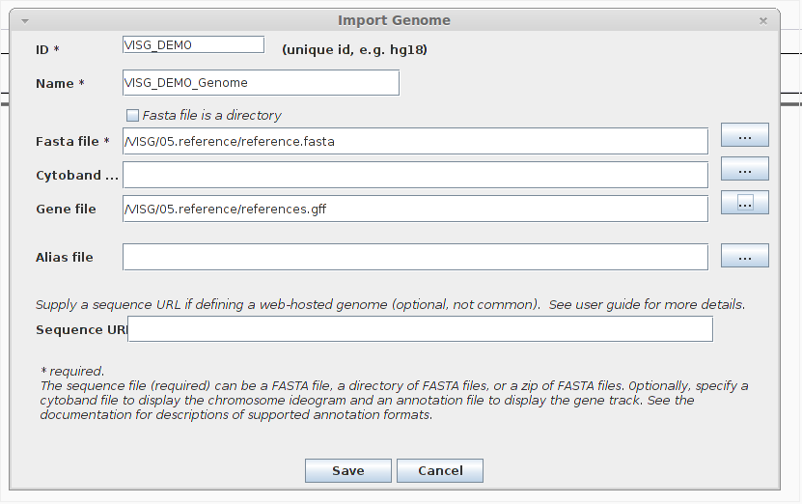
Start IGV and Set Up a Genome
igv & ##start up IGV in the background

Slide 46
IGV
Layer up file->load from file
  Vcf
  gff
  igv
  Bam
May need to sort and index
  file->run igvtools → command-> sort/index

Slide 47
Getting & Compiling Software-Github
cd ~/Downloads/
git clone https://github.com/lh3/wgsim.git
cd wgsim
less README ##read the instructions
gcc -g -O2 -Wall -o wgsim wgsim.c -lz -lm #compile
echo $PATH ##check your path
cp wgsim /usr/local/sbin ##copy to PATH
wgsim ##check it works, read help

Slide 48
reShape2
Flexible rshaping of data
Especially valuable for turning 'wide' into 'long' (stream-oriented') data
http://had.co.nz/reshape/
http://www.jstatsoft.org/v21/i12

Slide 49
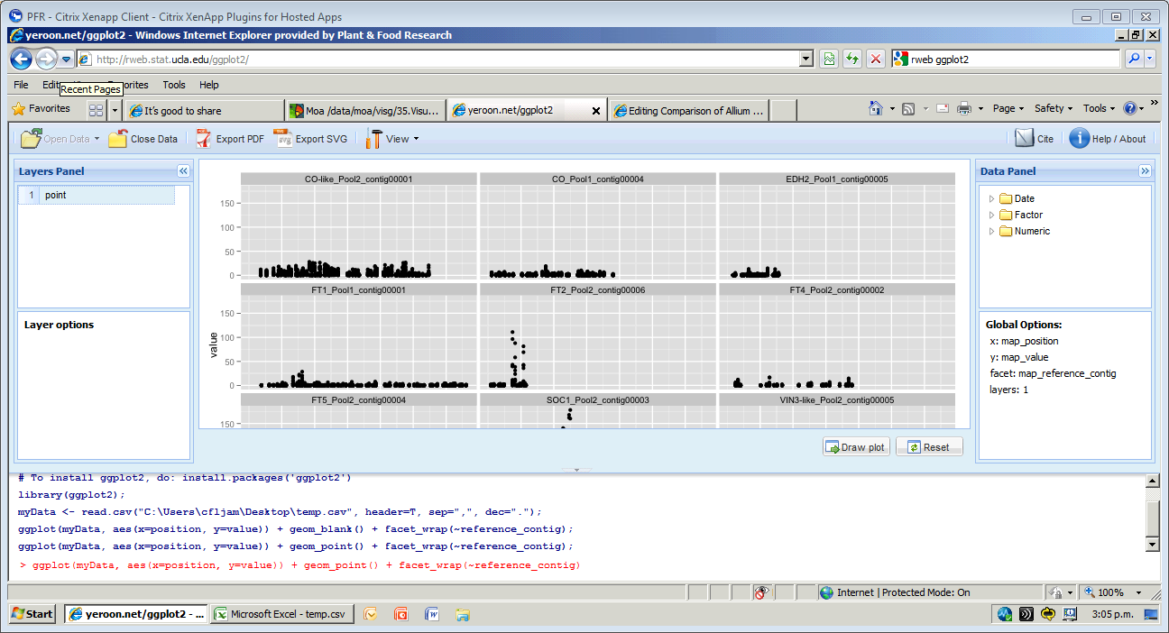
ggplot2
http://www.stat.ucla.edu/~jeroen/ggplot2/
http://had.co.nz/ggplot2/ http://docs.ggplot2.org/current/

Slide 50
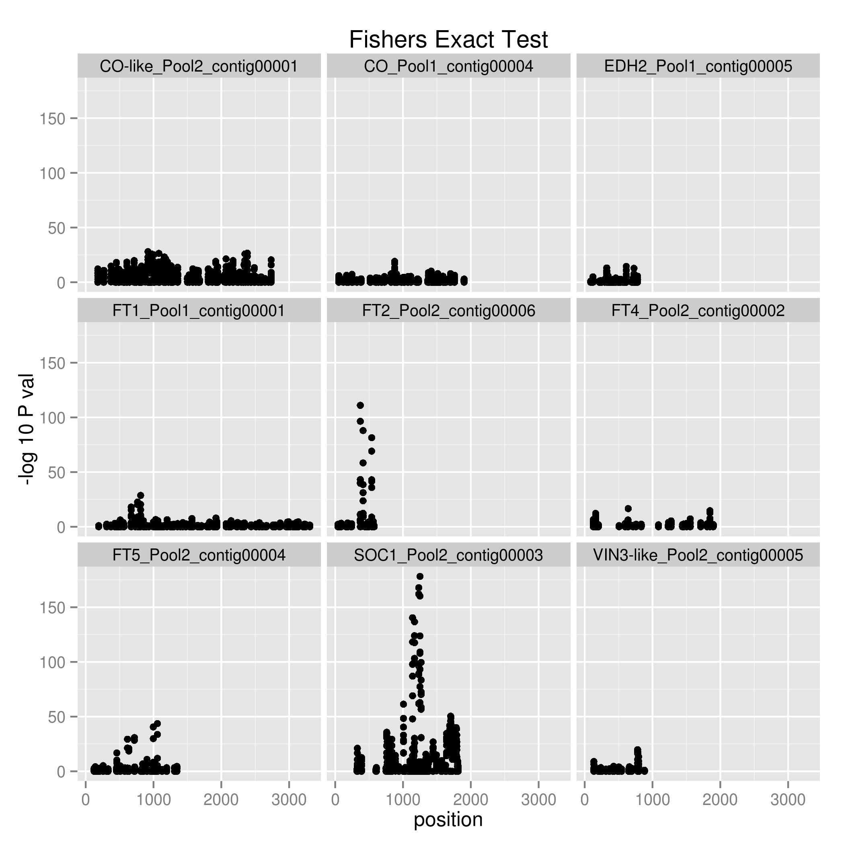
Conclusions & Directions
AcFT2 and AcSOC1 show strong differentiation among populations
Both peaks are adjacent to non-synonymous SNPs
Mapped most loci
Physiological data suggests AcFT2 associated with bulbing response
Bolting QTL on Chrom 1,3,6
Trying to map AcSOC1 in relation to chrom 1 QTL
Chr 4
Chr 6
Chr 4
Chr 3
Chr 1
Chr 5
Chr 6
Chr 6
Chr 1
Chr 5

Slide 51

Acknowledgements
Richard Macknight, Robyn Lough (Univ. Otago)
NZGL
Meeghan Pither-Joyce, Kathryn Wright, Martin Shaw, Roopa Revanna (PFR Onion Group)
Mark Fiers (Plant & Food)
MSI, MBI and MBIE

